Slide 1
Forecasting

Slide 2
Time Series Problem
Determine forecast for periods 7 & 8
2-period moving average
4-period moving average
2-period weighted moving average with t-1 weighted 0.6 and t-2 weighted 0.4
Exponential smoothing with alpha=0.2 and the period 6 forecast being 375
Period | Actual
1 | 300
2 | 315
3 | 290
4 | 345
5 | 320
6 | 360
7 | 375
8

Slide 3
Time Series Problem Solution
Period | Actual | 2-Period | 4-Period | 2-Per.Wgted. | Expon. Smooth.
1 | 300
2 | 315
3 | 290
4 | 345
5 | 320
6 | 360
7 | 375 | 340.0 | 328.8 | 344.0 | 372.0
8 |  | 367.5 | 350.0 | 369.0 | 372.6

Slide 4
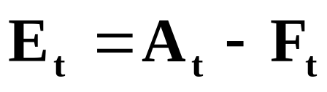
Measuring Forecast Error
Forecasts are never perfect
Need to know how much we should rely on our chosen forecasting method
Measuring forecast error:
Note that over-forecasts = negative errors and under-forecasts = positive errors
© Wiley 2010

Slide 5

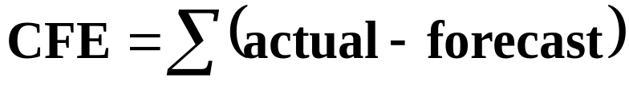
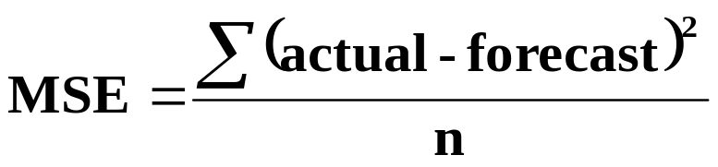
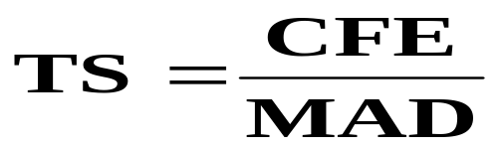
Measuring Forecasting Accuracy
Mean Absolute Deviation (MAD)
  measures the total error in a forecast without regard to sign
Cumulative Forecast Error (CFE)
  Measures any bias in the forecast
Mean Square Error (MSE)
  Penalizes larger errors
Tracking Signal
  Measures if your model is working
© Wiley 2010

Slide 6
Accuracy & Tracking Signal Problem: A company is comparing the accuracy of two forecasting methods. Forecasts using both methods are shown below along with the actual values for January through May. The company also uses a tracking signal with ±4 limits to decide when a forecast should be reviewed. Which forecasting method is best?
Month | Actual sales | Method A |  |  |  | Method B
 |  | F’cast | Error | Cum. Error | Tracking Signal | F’cast | Error | Cum. Error | Tracking Signal
Jan. | 30 | 28 | 2 | 2 | 2 | 27 | 2 | 2 | 1
Feb. | 26 | 25 | 1 | 3 | 3 | 25 | 1 | 3 | 1.5
March | 32 | 32 | 0 | 3 | 3 | 29 | 3 | 6 | 3
April | 29 | 30 | -1 | 2 | 2 | 27 | 2 | 8 | 4
May | 31 | 30 | 1 | 3 | 3 | 29 | 2 | 10 | 5
MAD |  |  | 1 |  |  |  | 2
MSE |  |  | 1.4 |  |  |  | 4.4
© Wiley 2010

